Slide 1

BEERTASTIC
DESIGN AND IMPLEMENTATION OF MOBILE APPLICATION
Andrea Costanzo

Slide 2


THE REASONS BEHIND ITS DESIGN
At the first impact, approaching the world of craft beer and breweries can make you feel disoriented. For this reason, we developed Beertastic: a straightforward and intuitive application to enjoy the experience of a good craft beer while exploring curiosities about breweries.

Slide 3

PRODUCT DESCRIPTION
FRAMEWORK & USER INTERFACES

Slide 4




WHY LUTTER?
PORTABILITY
RICH IN COMPONENTS
HIGH PERFORMANCE
With a single code base is possible to create a product that would fit both iOS and Android devices. Furthermore, it is possible to use it to create web and desktop apps, but these features are still under testing.
Flutter has a lot of UI components that come together with the framework, without the need for installing a lot of external libraries to design interfaces.
Flutter has very high performances thanks to how it works under the hood. It never uses web views or bridge to render the UI elements, but it uses his rendering engine, which is built mostly in C++.

Slide 5
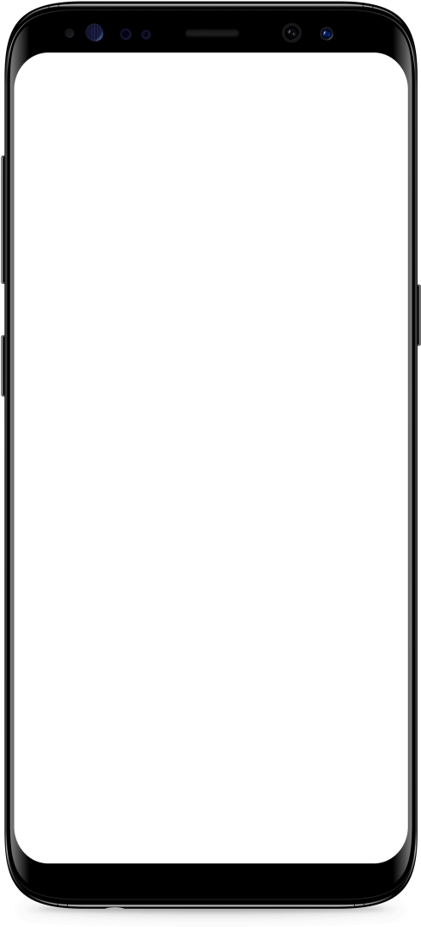
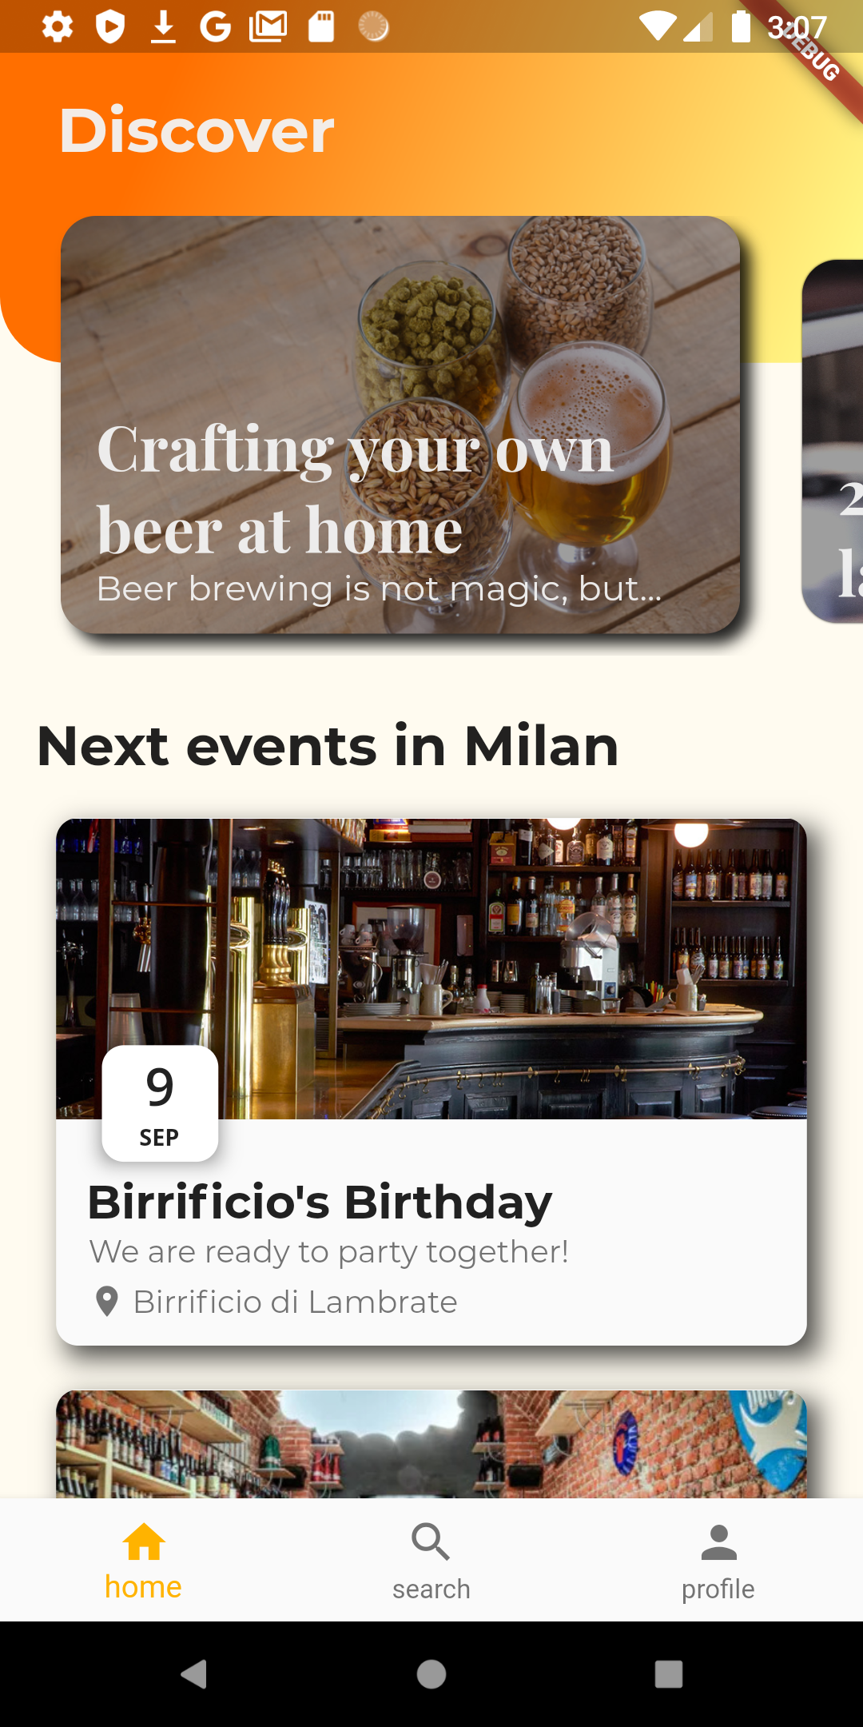
Articles and events
Home page
This is the home screen of the application. From here, users can see events and read articles covering various topics. After opening an article, users can scroll to start reading it. Event page, on the other side, contains multiple information on the event, like the date, the description and the place where the event is held.

Slide 6

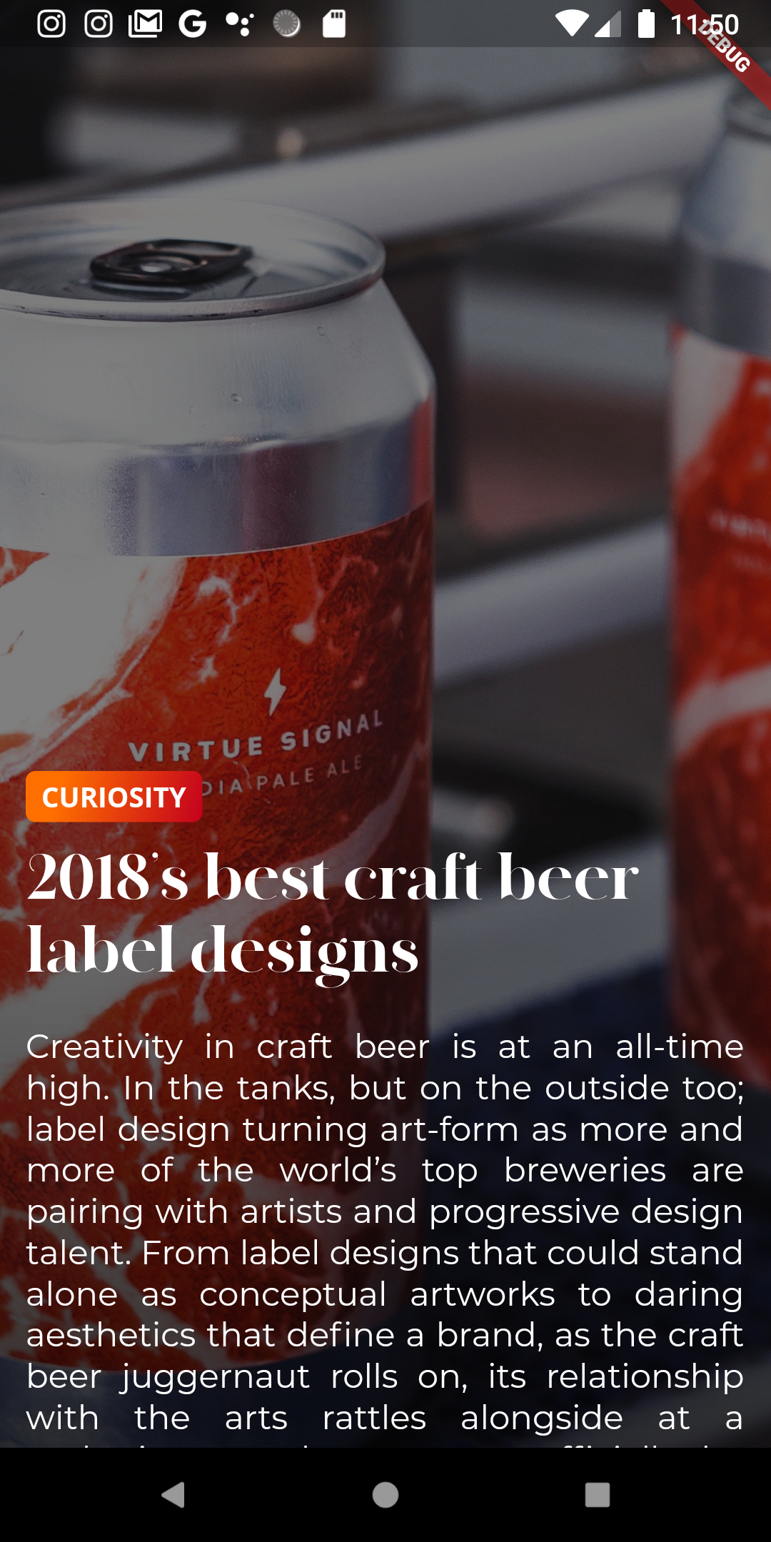
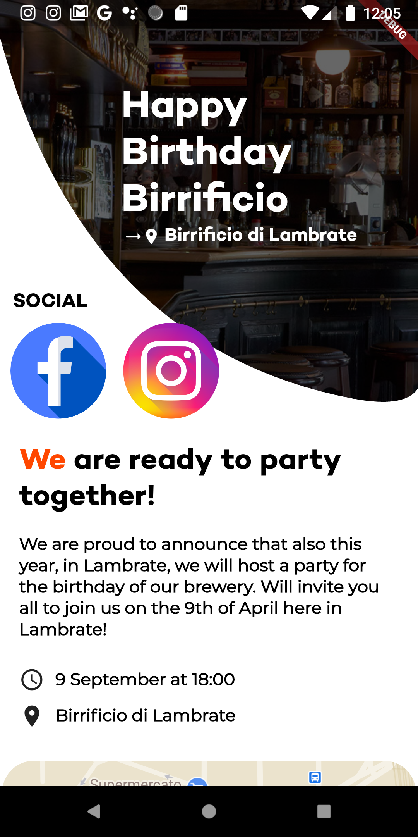
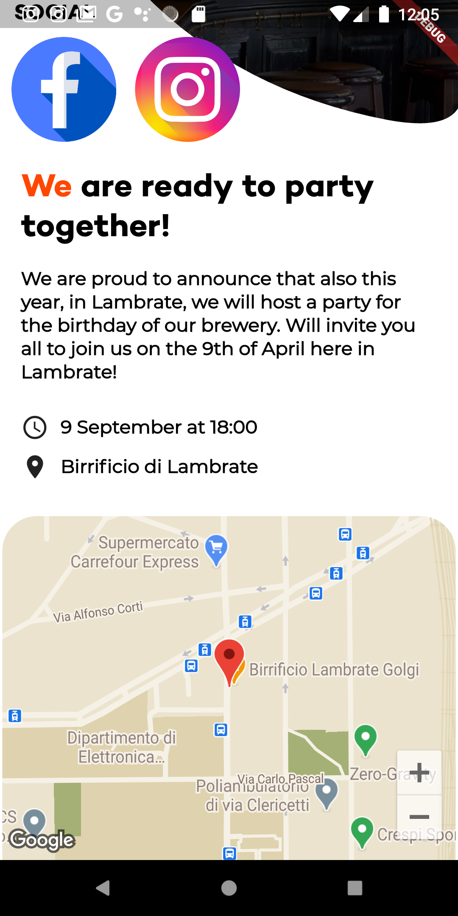

Slide 7
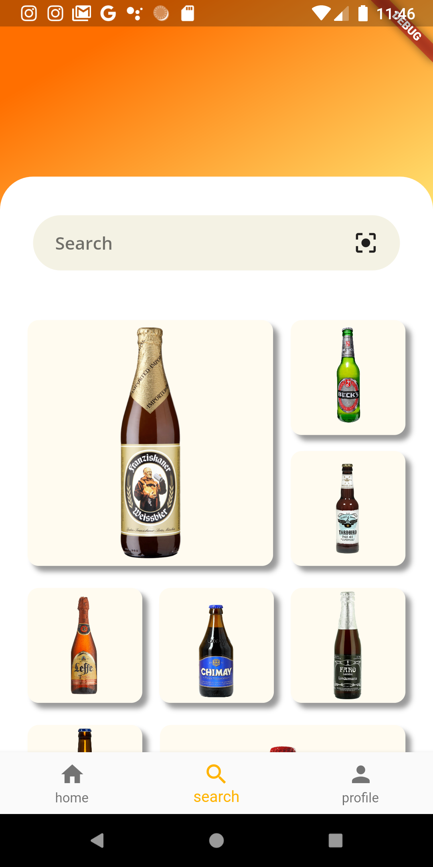
Search and explore beers
Search page
The second screen of the navigation bar is the search page. Here users can explore beer suggested by us or search a beer they are drinking using its name or by scanning its bar code. After opening a beer, the user finds some relevant information. If he wants to know further, he can click on the beer button to check additional data on the beer, read an expert review or see its statistic. On the other side, if he wants to know what the community think about the beer, the user will have to click on the rate of the beer to check reviews.

Slide 8

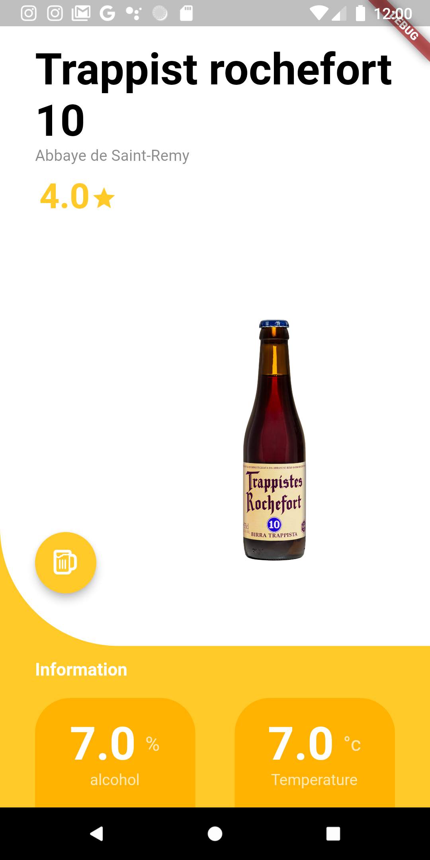
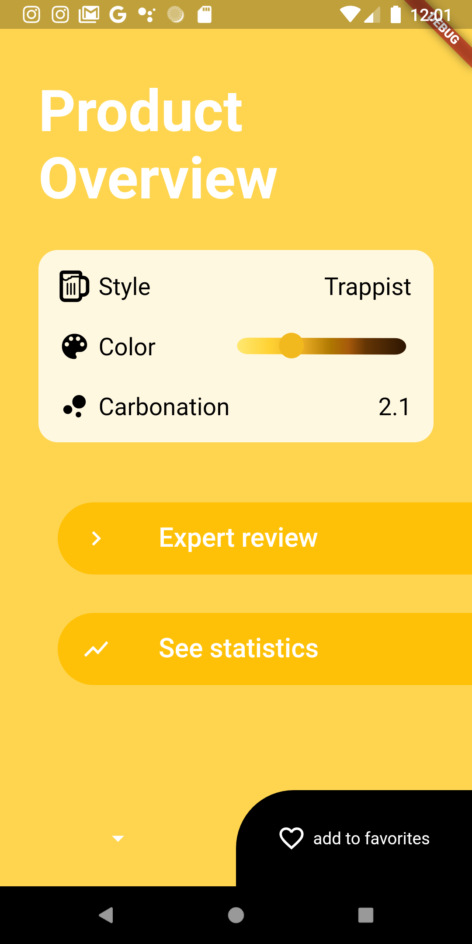
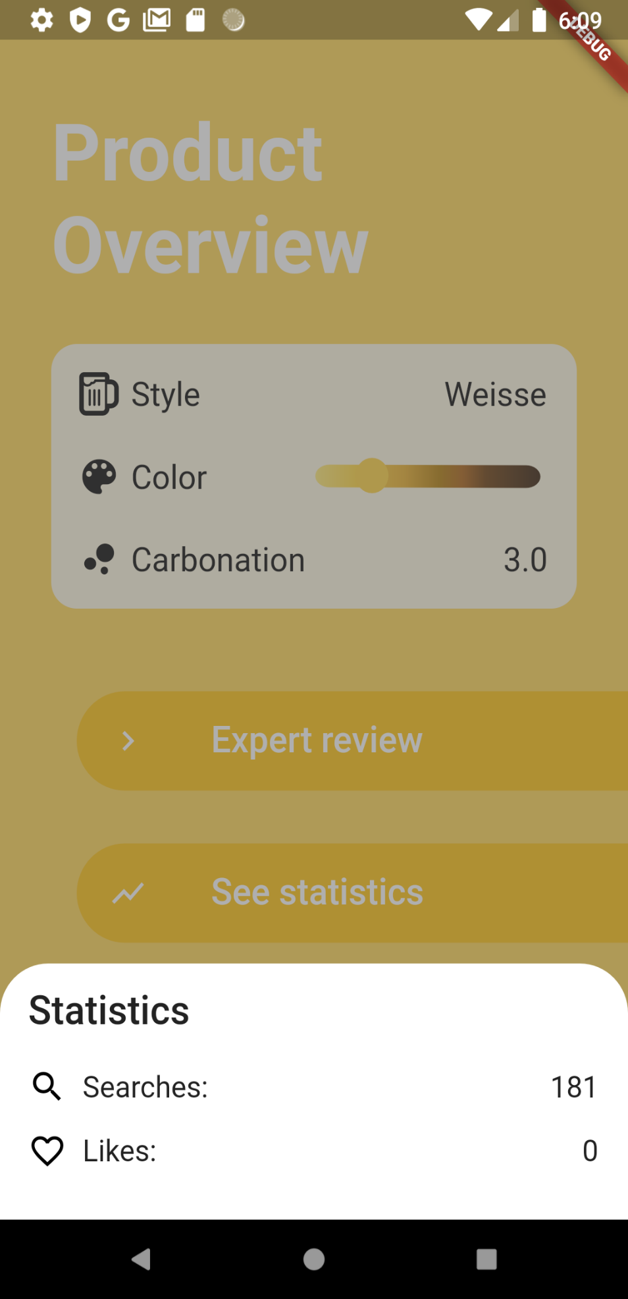

Slide 9
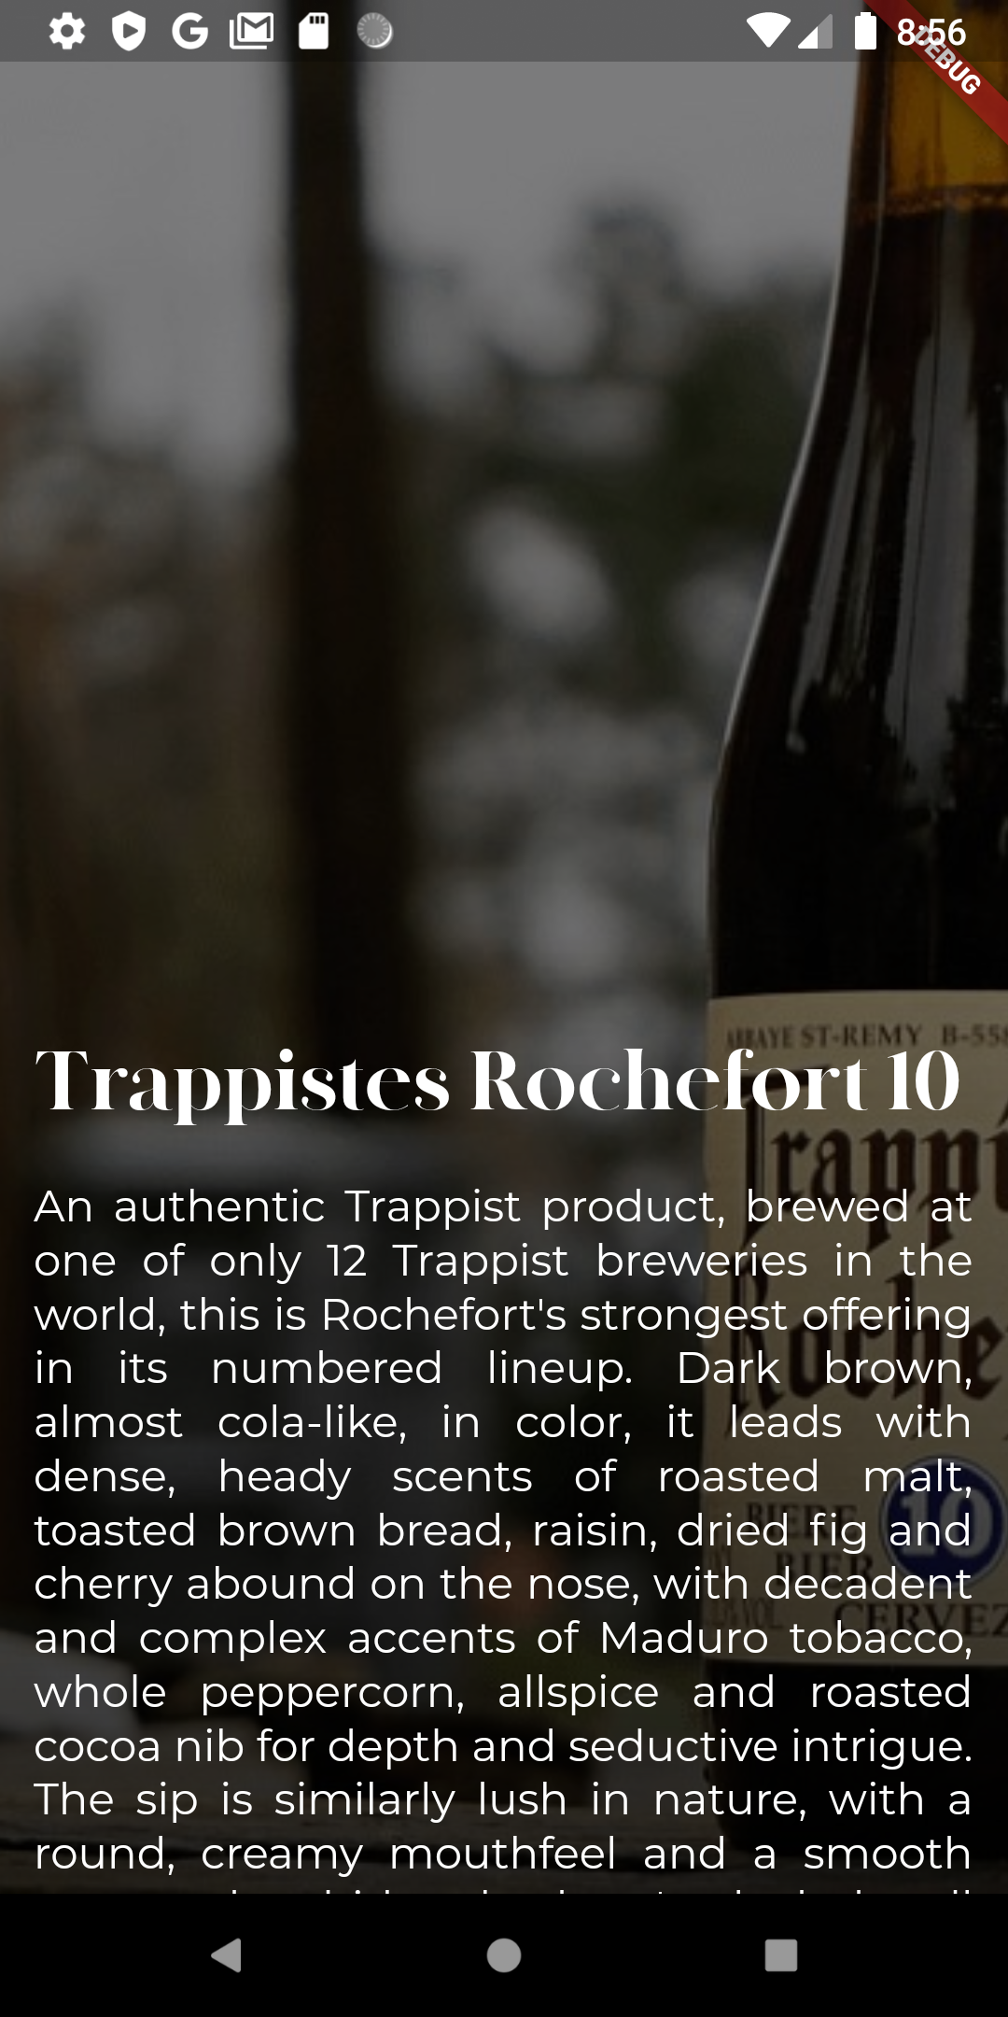
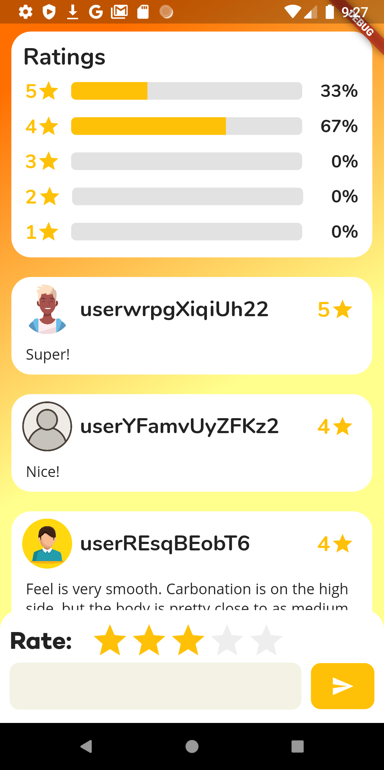
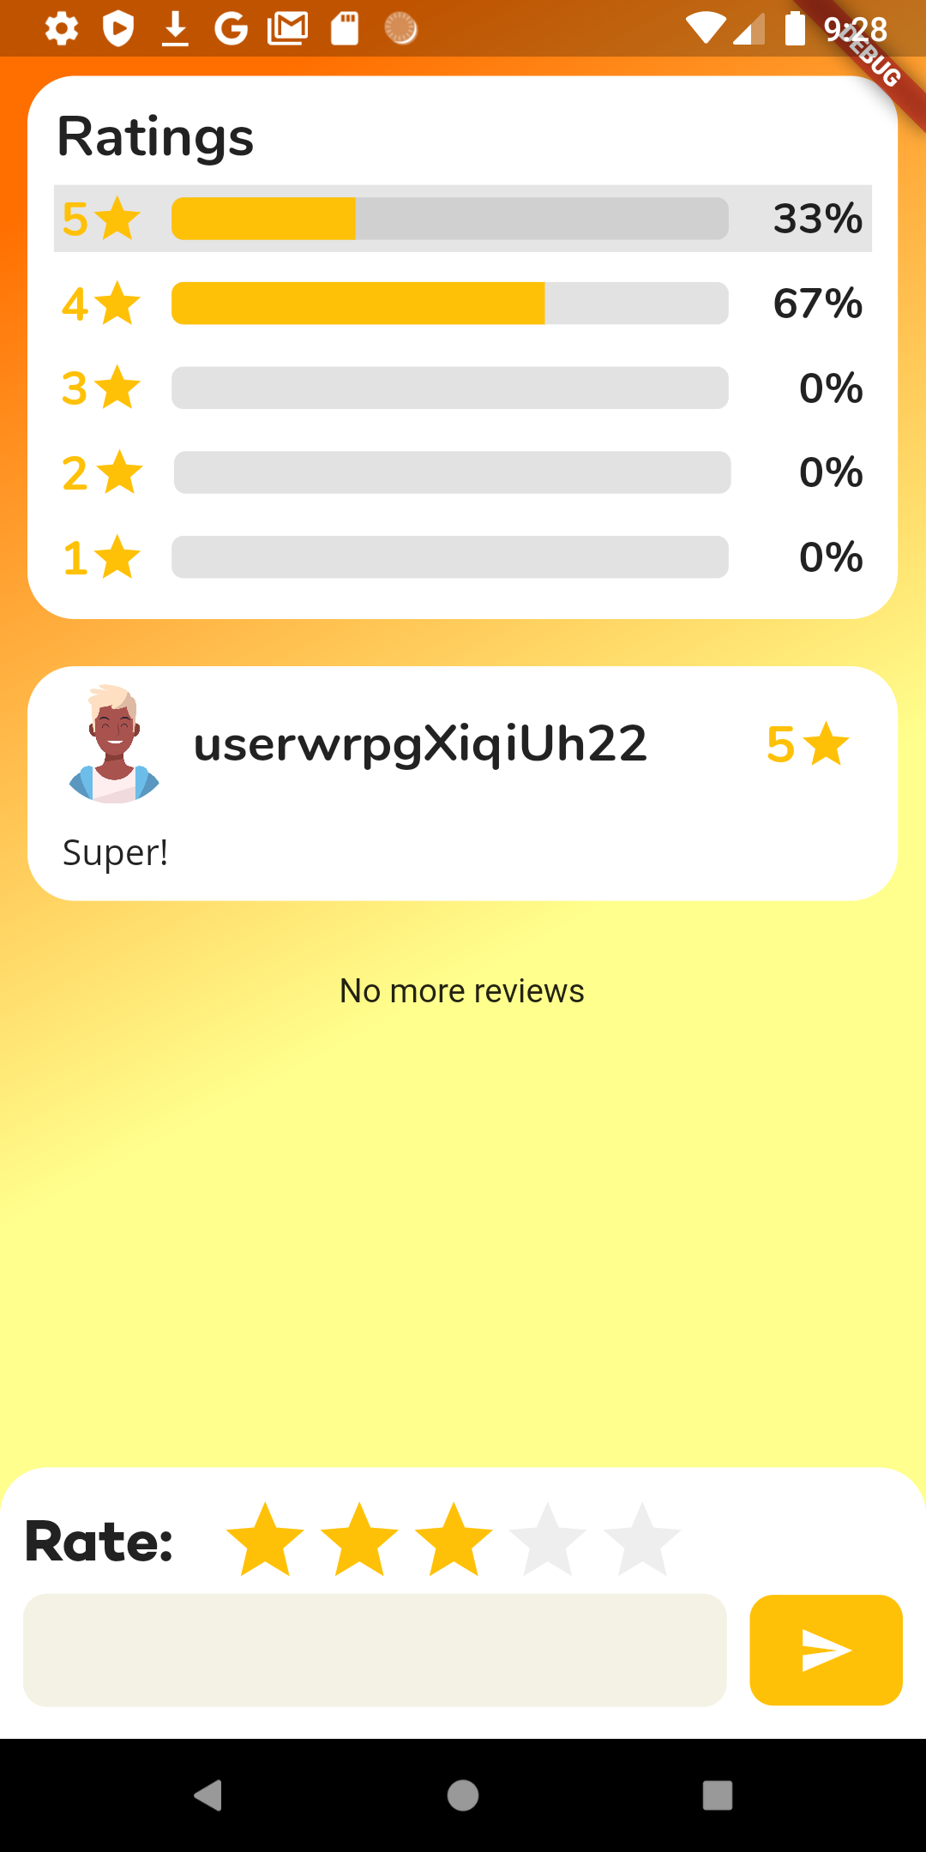

Slide 10
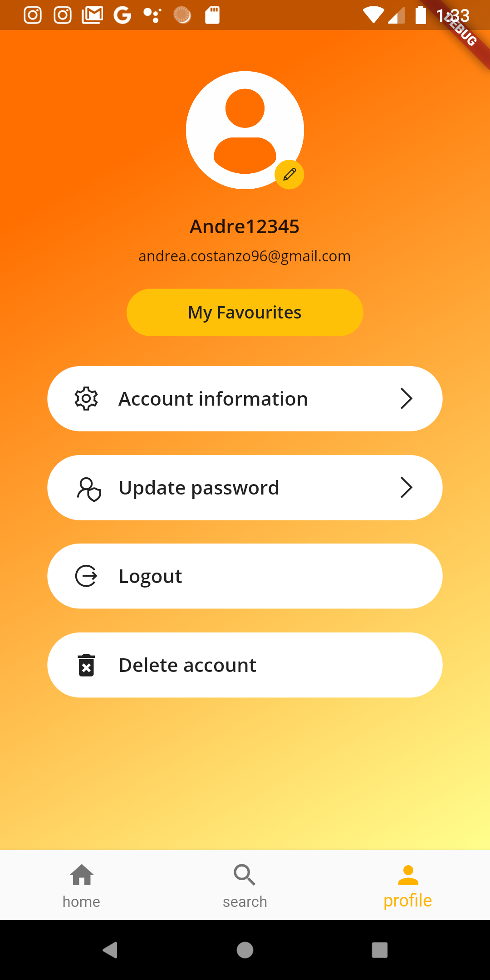
User’s profile
Profile page
The profile page is the third main screen of the application. From this screen users can perform different operations: they can modify their profile image, update their nickname and city, send an email to change the password or they can delete the account. For the last operation, users need to be authenticated recently; otherwise, the system will ask them to re-authenticate.

Slide 11
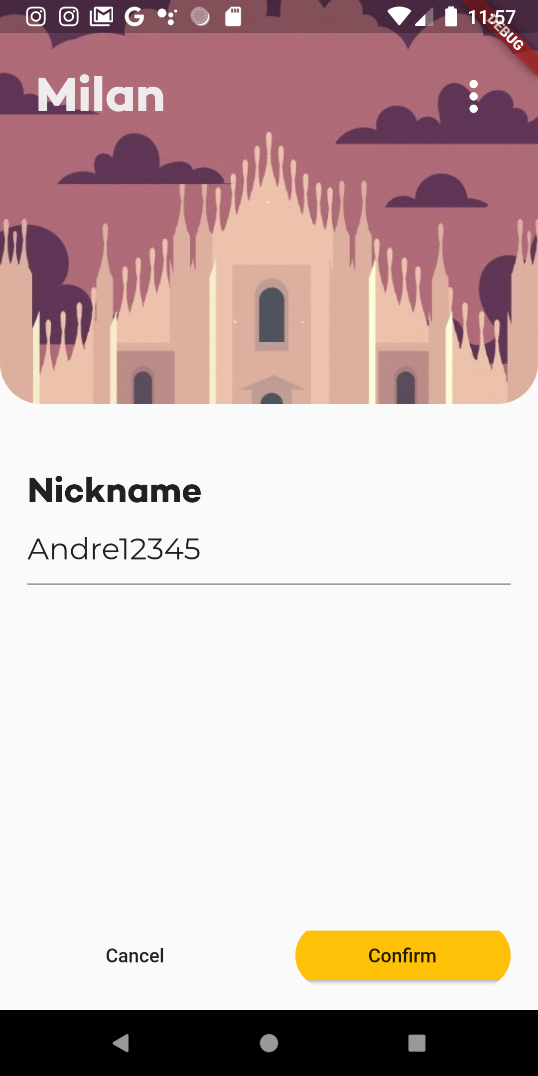
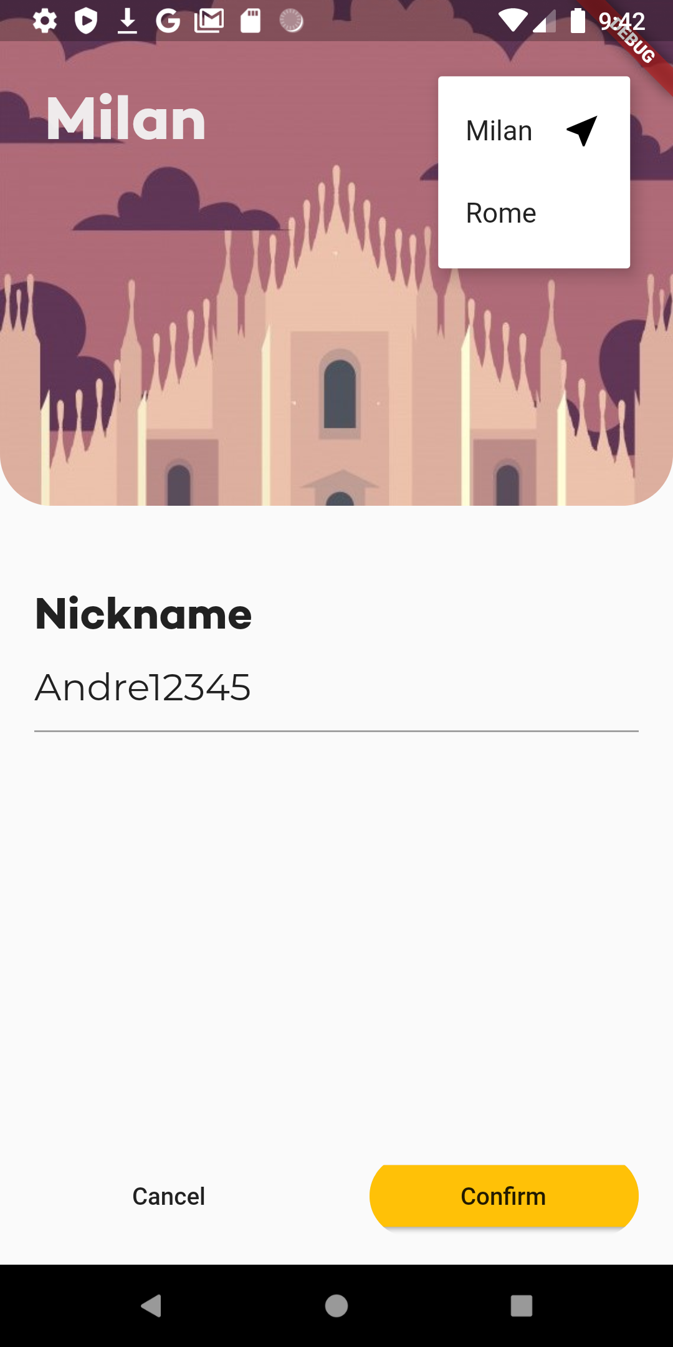
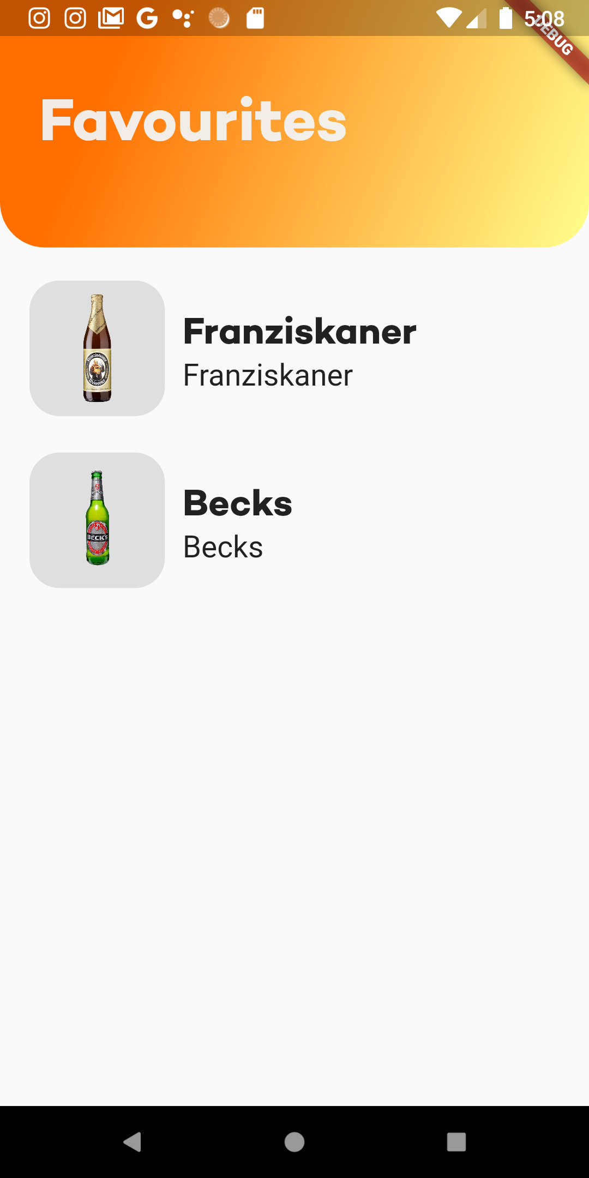

Slide 12
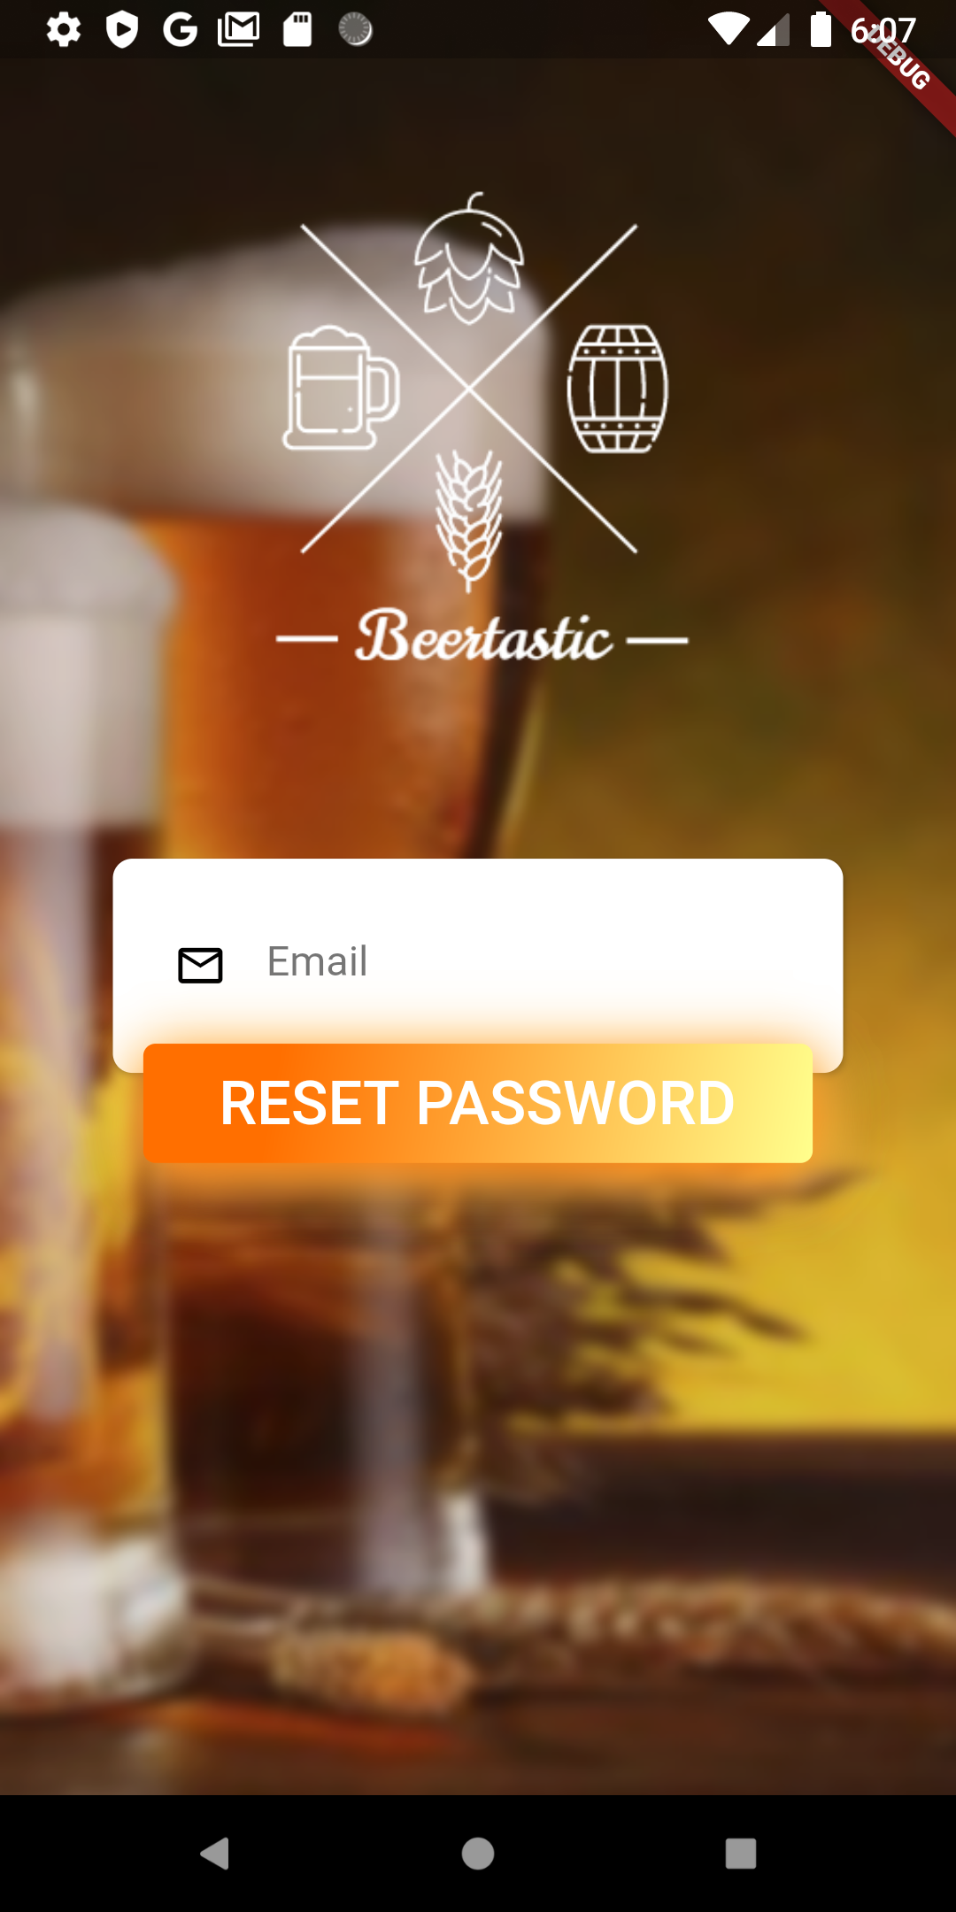
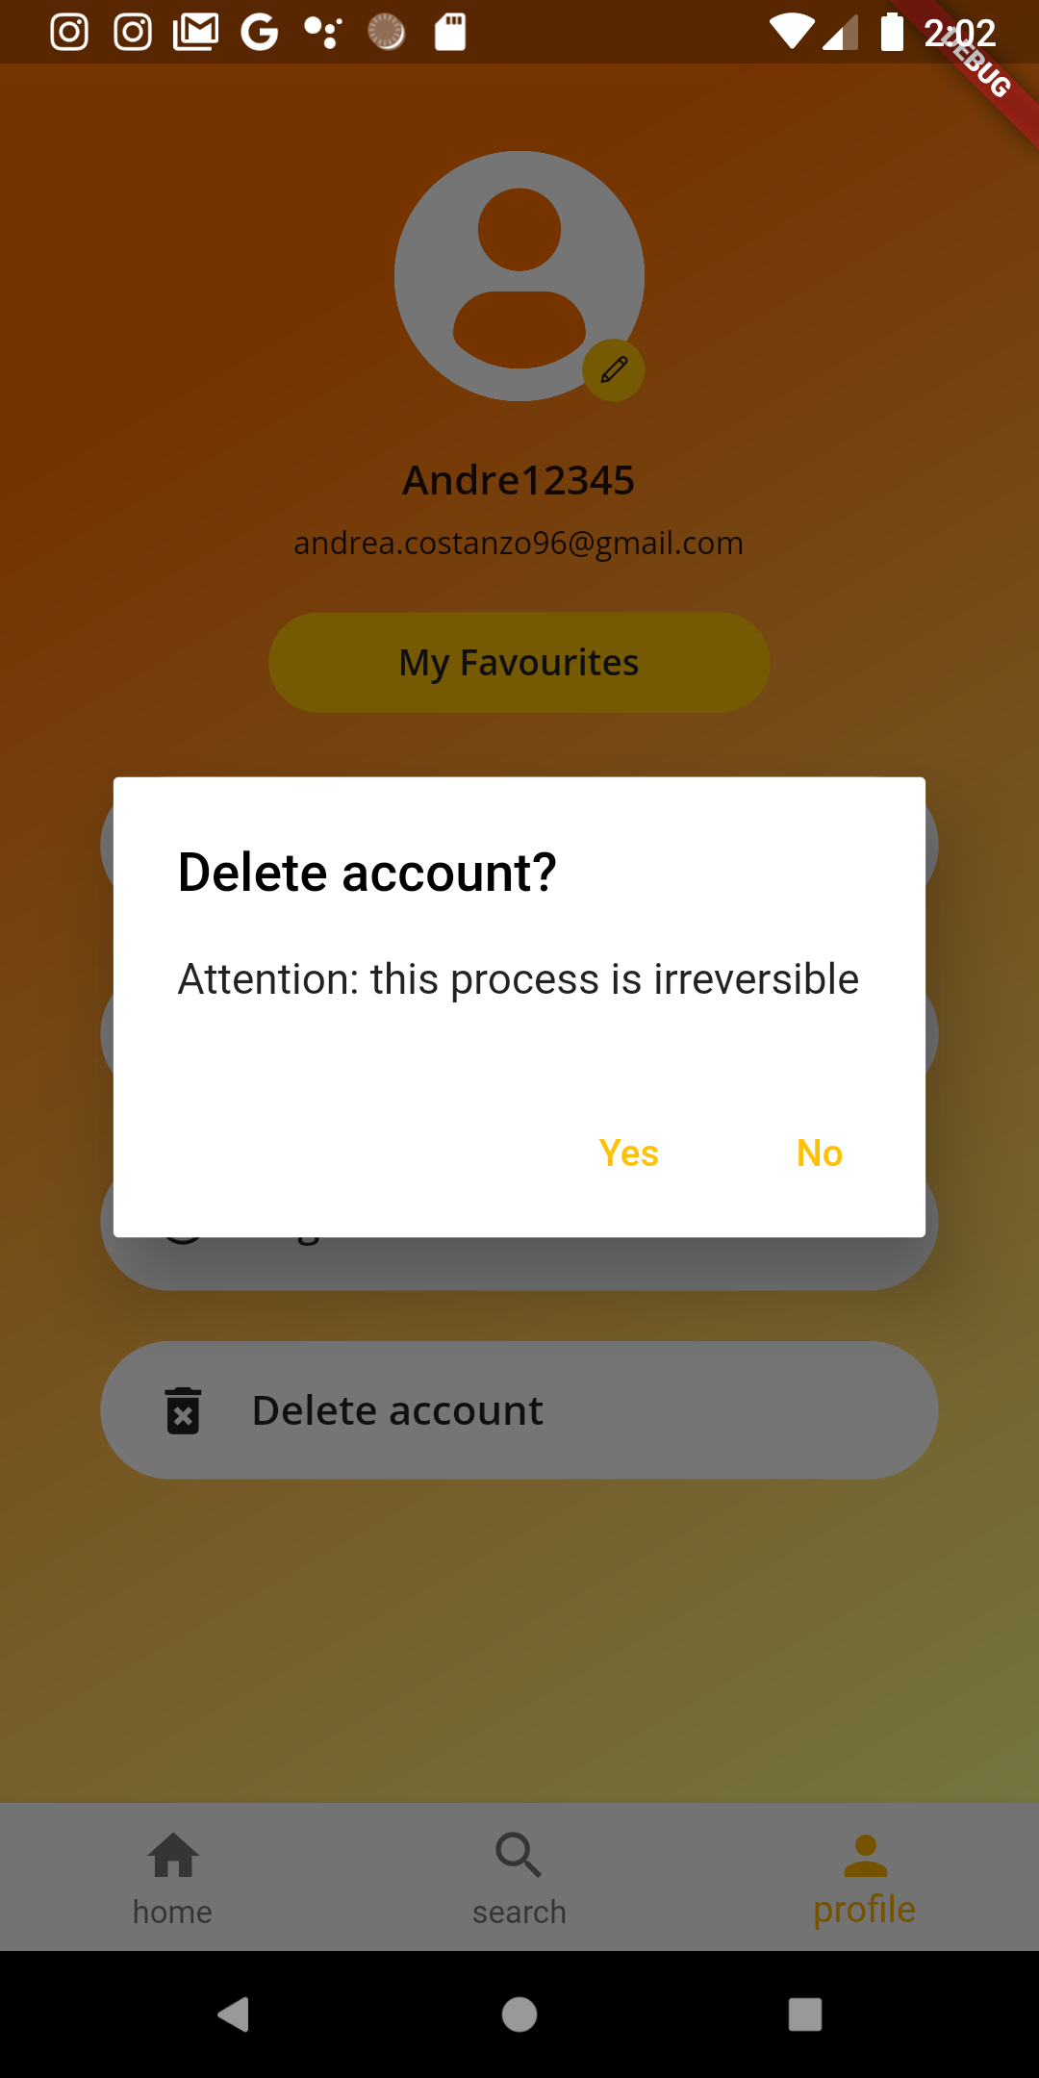
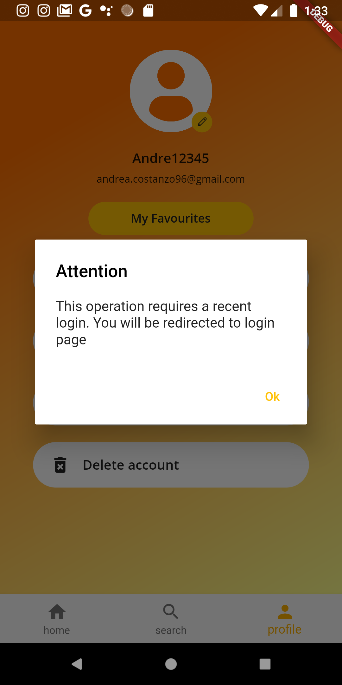

Slide 13
ARCHITECTURE
BACK-END, LIBRARIES AND MORE

Slide 14




THE BACK-END: FIREBASE
FIREBASE AUTHENTICATION
CLOUD FIRESTORE
CLOUD FUNCTIONS
FIREBASE STORAGE
It is a service to authenticate users and securely store user credential, along with additional parameters that can be set as custom claims.
It is a powerful NoSQL database where the time to read documents depends on the query size and not on the one of the dataset.
It is a serverless framework that lets you automatically run backend code in response to events triggered by Firebase features and HTTPS requests.
It is a powerful, simple, and cost-effective storage space used to store and save collections of large files like images.

Slide 15


GOOGLE MAPS
We included the flutter plugin to integrate google maps in our service. The objective was to give users the possibility to launch google maps with the event place from inside the app.
GEOLOCATOR
A Flutter geolocation plugin which provides easy access to platform-specific location services. We used it in the application to retrieve the current user location to compute cities near to users.

Slide 16
OTHER CHOICES
Flare Flutter
BLoCs & Pagination
1
I used this library to add custom animated components to flutter. An example is the color bar in the details of beers.
3
To decouple the UI from firebase plugins, I implemented Business Logic Components. Furthermore pagination is implemented to avoid to put too much weight on network requests.
Geohashes
Method Channels
2
To efficiently retrieve cities in a defined area, we used an algorithm to compute the geohash of the current user position.
4
I used them to run native android code when I need to fill flutter gaps and bugs. They were useful to access hardware components more efficiently.

Slide 17


FIREBASE ML
We decided to use Firebase ML Kit to scan barcodes and QR codes. This module does not connect to the backend but runs the analysis locally since the required computational power to perform these operations is not too heavy for the processor.
CAMERA X
CameraX is a Jetpack support library, built to help developers make camera app development easier. We use this library together with Firebase ML Kit to perform the scan of bar codes and QR codes.

Slide 18
DESIGN & TESTING
AND FINAL CONSIDERATIONS

Slide 19
DESIGN
Sources
Legibility
1
To design the various screen, we followed the guidelines provided by the course and by Google Material Design. Sometimes Dribbble was a source of inspiration.
3
To facilitate users reading process, we made sure that the contrast between text and background was always enough.
Navigation
Interactive elements
2
Since we divided the app into three main sections, the most suited navigation element to use was a navigation tab.
4
With the goal in mind of developing an app easy to handle for our users, we decided to put particular focus on how interactive elements, like buttons and cards, should behave.

Slide 20
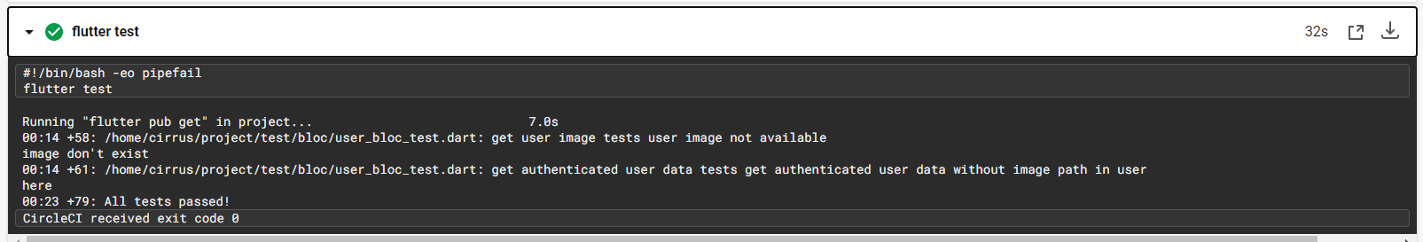
DEBUG
TESTING INFORMATION
The application is mainly tested through debugging to check that the integration between firebase and the application was performed correctly.
To automate the debug process I tried to use firebase test labs, but they are not available for flutter applications.
UNIT TESTING
Unit testing was mainly used as a measure to check that the core elements of the BLoCs were implemented correctly. Because of some issues related to third-party packages, we only reached the 75% of coverage (for a total of 79 tests).
CIRCLECI & CODECOV
To automate the testing process, I decided to use the CircleCI platform to run unit tests at every push on Github. Furthermore, I used Codecov to have a detailed report of the test coverage.

Slide 21

FINAL CONCLUSIONS
DEVELOPMENT
The development of an application moves the focus from the product to the user and his experience.
FRAMEWORK
Flutter is a very powerful and performant framework, with an active community supporting it. However, it's still in its early days and sometimes presents errors. Furthermore, for what concerns the Firebase integration, it sometimes lacks in the documentation.
EXPERIENCE
The overall project was challenging since I never dealt with both mobile development and external services and APIs like Firebase.

Slide 22

THANK YOU FOR THE ATTENTION
BEERTASTIC

